Slide 1


Amateur Extra Licensing Class
Logically Speaking of Counters
Presented by
W5YI
Arlington, Texas

Slide 2
Amateur Radio Extra Class
Element 4 Course Presentation
ELEMENT 4 Groupings
  Rules & Regs
  Skywaves & Contesting
  Outer Space Comms
  Visuals & Video Modes
  Digital Excitement with Computers & Radios
  Modulate Your Transmitters
  Amps & Power Supplies
  Receivers with Great Filters

Slide 3
Amateur Radio Extra Class
Element 4 Course Presentation
ELEMENT 4 Groupings
  Oscillate & Synthesize This!
  Circuits & Resonance for All!
  Components in Your New Rig
  Logically Speaking of Counters
  Optops & OpAmps Plus Solar
  Test Gear, Testing, Testing 1,2,3
  Antennas
  Feedlines & Safety

Slide 4
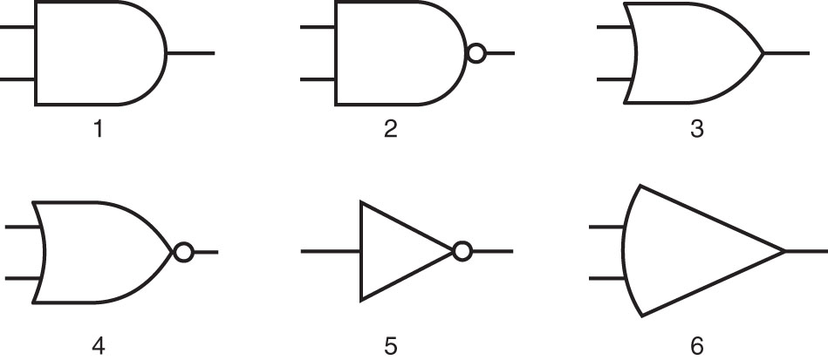
Amateur Radio Extra Class
Logically Speaking of Counters
E6C07… In Figure E6-5, the schematic symbol for an AND gate is number 1
E6C08… In Figure E6-5, the schematic symbol for a NAND gate is number 2
Input A | Input B | Output
0 | 0 | 0
0 | 1 | 0
1 | 0 | 0
1 | 1 | 1
If inputs A and B are 1 then the output is 1.
Figure E6-5
Input A | Input B | Output
0 | 0 | 1
0 | 1 | 1
1 | 0 | 1
1 | 1 | 0
If not A and B are 1 then the output is 1.

Slide 5
Amateur Radio Extra Class
Logically Speaking of Counters
E6C09… In Figure E6-5, the schematic symbol for an OR gate is number 3.
E6C10… In Figure E6-5, the schematic symbol for a NOR gate is number 4.
Input A | Input B | Output
0 | 0 | 0
0 | 1 | 1
1 | 0 | 1
1 | 1 | 1
If either A or B input are 1 then the output is 1.
Figure E6-5
Input A | Input B | Output
0 | 0 | 1
0 | 1 | 0
1 | 0 | 0
1 | 1 | 0
If neither A or B are 1 then the output will be 1.

Slide 6
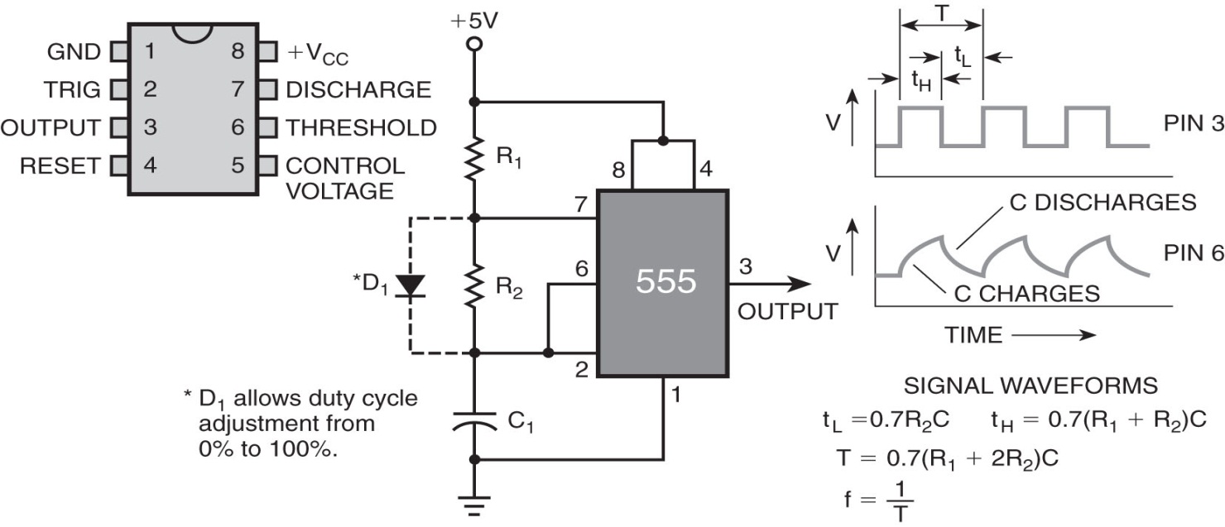
Amateur Radio Extra Class
Logically Speaking of Counters
E6C11… Figure E6-5 shows the schematic symbol for the NOT operation (inverter) is number 5.
E7A01… A flip-flop is a bistable circuit.
Input | Output
0 | 1
1 | 0
If the input is high the output is low, if the input is low the output will be high
Bistable means that it can remain in a 1 or 0 state after being driven by a single input pulse or bit. Each input pulse will cause it to change state from a 1 to a 0 or a 0 to a 1.

Slide 7
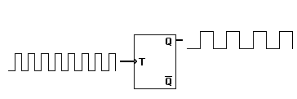
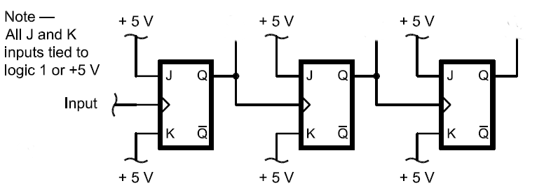
Amateur Radio Extra Class
Logically Speaking of Counters
E7A02… Two output level changes occur for every two trigger pulses applied to the input of a "T" (triggered) flip-flop circuit.
E7A03… A flip-flop can divide the frequency of the pulse train by 2.
E7A04… Two flip-flops are required to divide a signal frequency by 4.
Input
Every rising edge toggles the output (makes it change state). The rise on the first pulse sets the output high the rise from the second pulse sets the output low (two state changes).
Output
Output
50 KHz
Output
25 KHz
Output
12.5 KHz
Input
100 KHz

Slide 8
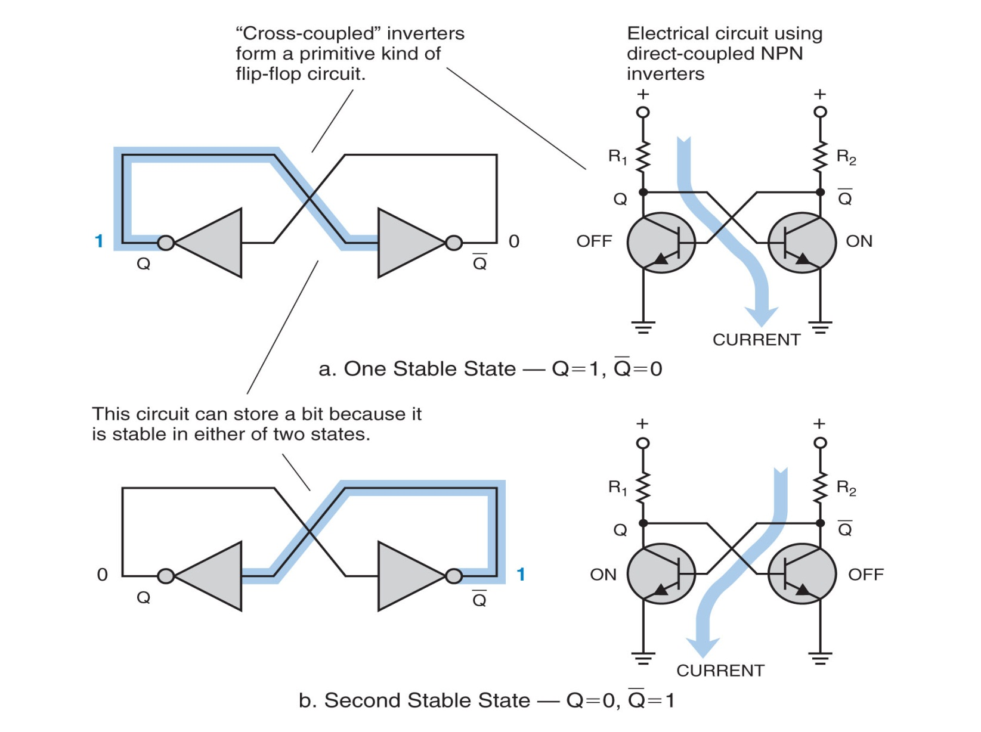
Amateur Radio Extra Class
Logically Speaking of Counters
Basic concept of the flip-flop
Also called a bistable element
Also called a static memory element

Slide 9
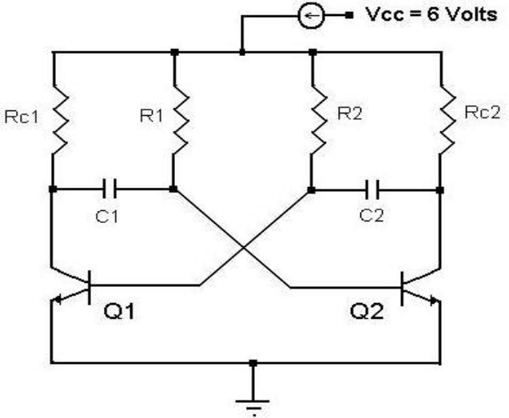
Amateur Radio Extra Class
Logically Speaking of Counters
E7A05… An astable multivibrator is a circuit that continuously alternates between two unstable states without an external clock.
E7A06… The characteristic of a mono-stable multivibrator is that it switches momentarily to the opposite binary state and then returns, after a set time, to its original state.

Slide 10
Amateur Radio Extra Class
Logically Speaking of Counters
E7A07… An AND gate produces a logic "1" at its output only if all inputs are logic "1".
E7A08… A NAND gate produces a logic "0" at its output only when all inputs are logic "1".
Input A | Input B | Output
0 | 0 | 0
0 | 1 | 0
1 | 0 | 0
1 | 1 | 1
If inputs A and B are 1 then the output is 1.
Input A | Input B | Output
0 | 0 | 1
0 | 1 | 1
1 | 0 | 1
1 | 1 | 0
If not A and B are 1 then the output is 1.

Slide 11
Amateur Radio Extra Class
Logically Speaking of Counters
E7A09… An OR gate produces a logic "1" at its output if any or all inputs are logic "1".
E7A10… A NOR gate produces a logic "0" at its output if any or all inputs are logic "1".
Input A | Input B | Output
0 | 0 | 0
0 | 1 | 1
1 | 0 | 1
1 | 1 | 1
If either A or B input are 1 then the output is 1.
Input A | Input B | Output
0 | 0 | 1
0 | 1 | 0
1 | 0 | 0
1 | 1 | 0
If neither A or B are 1 then the output will be 1.

Slide 12
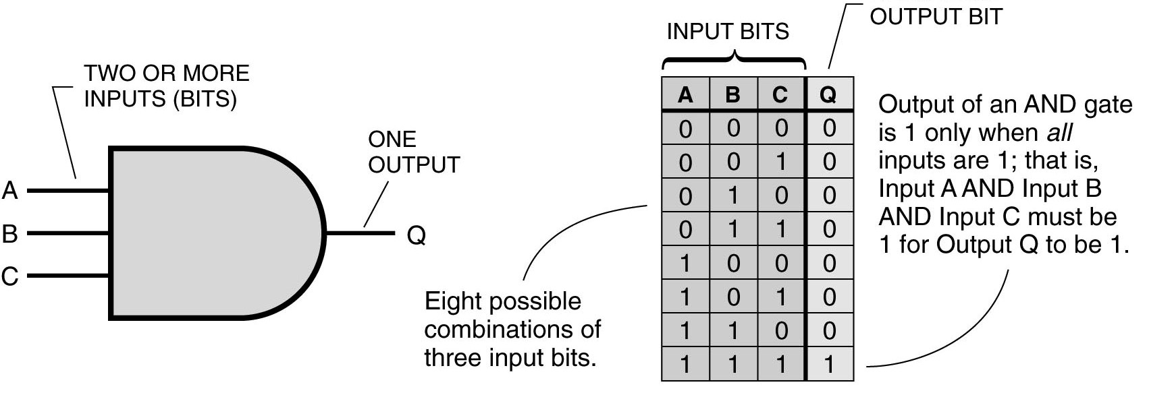
Amateur Radio Extra Class
Logically Speaking of Counters
E7A11… A list of input combinations and corresponding outputs for a digital device is a called a truth table.
Diagram Symbol
Truth Table
A 3-Input AND gate

Slide 13
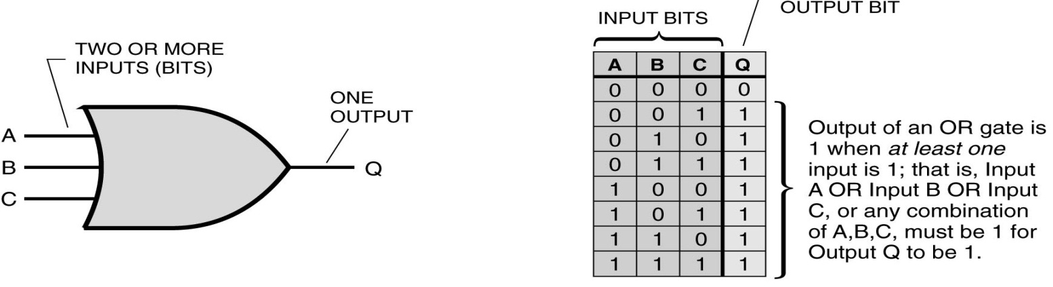
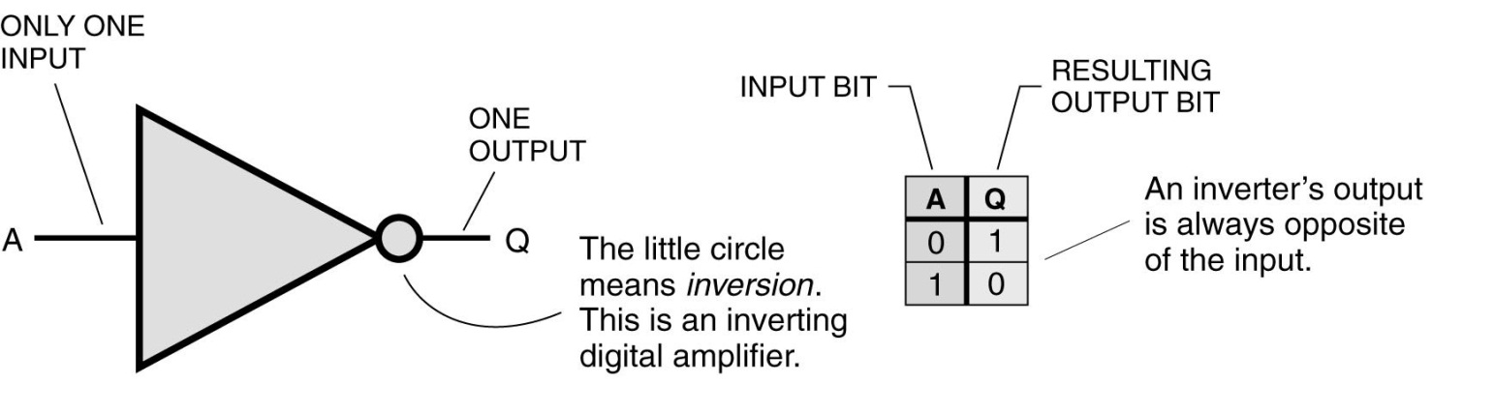
Amateur Radio Extra Class
Logically Speaking of Counters
Diagram Symbol
Truth Table
A 3-Input OR Gate
Diagram Symbol
Truth Table
A NOT Gate Inverter

Slide 14
Amateur Radio Extra Class
Logically Speaking of Counters
E7A12… The name for logic which represents logic "1" as a high voltage is Positive Logic.
E7A13… The name for logic which represents logic "0" as a high voltage is Negative logic.
E7F01… The purpose of a prescaler circuit is to divide a higher frequency signal so a low-frequency counter can display the operating frequency.
E7F02… A prescaler would be used to reduce a signal’s frequency by a factor of ten.
E7F03… The function of a decade counter digital IC is to produce one output pulse for every ten input pulses.
  A decade counter (divider) can be used as a prescaler for a counter (assuming it works high enough in frequency) to increase the counters frequency range by a factor of 10 (allowing a 10 MHz counter to have an extended frequency range to100 MHz). A circuit with 2 decade dividers in series would divide the input by 100, extending the range of our 10 MHz to 1,000 MHz

Slide 15
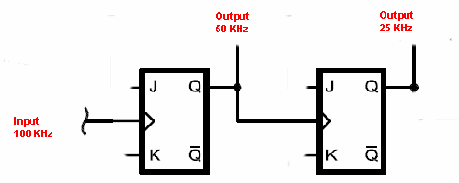
Amateur Radio Extra Class
Logically Speaking of Counters
E7F04… Two flip-flops must be added to a 100-kHz crystal-controlled marker generator so as to provide markers at 50 and 25 kHz.
E7F05… A 1 MHz oscillator and a decade counter circuit can be combined to produce a 100 kHz fundamental signal with harmonics at 100 kHz intervals.
E7F06… A crystal marker generator consists of a crystal-controlled oscillator that generates a series of reference signals at known frequency intervals

Slide 16
Amateur Radio Extra Class
Logically Speaking of Counters
E7F07… A crystal oscillator followed by a frequency divider circuit would be a good choice for generating a series of harmonically related receiver calibration signals.
E7F08… One purpose of a marker generator is to provide a means of calibrating a receiver's frequency settings.
E7F09… The accuracy of the time base determines the accuracy of a frequency counter.
E7F10… A conventional frequency counter determines the frequency of a signal by counting the number of input pulses occurring within a specific period of time.

Slide 17
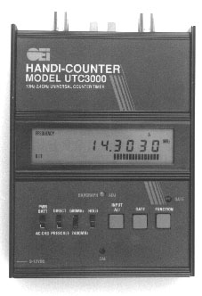
Amateur Radio Extra Class
Logically Speaking of Counters
E7F11… The purpose of a frequency counter is to provide a digital representation of the frequency of a signal.
E7F12… Period measurement is an alternate method of determining frequency, other than by directly counting input pulses, and is used by some frequency counters.
E7F13… The advantage of a period-measuring frequency counter over a direct-count type is that it provides improved resolution of signals within a comparable time period

Slide 18

Element 4 Extra Class
Question Pool
  Logically Speaking of Counters
Valid July 1, 2008
Through
June 30, 2012

Slide 19
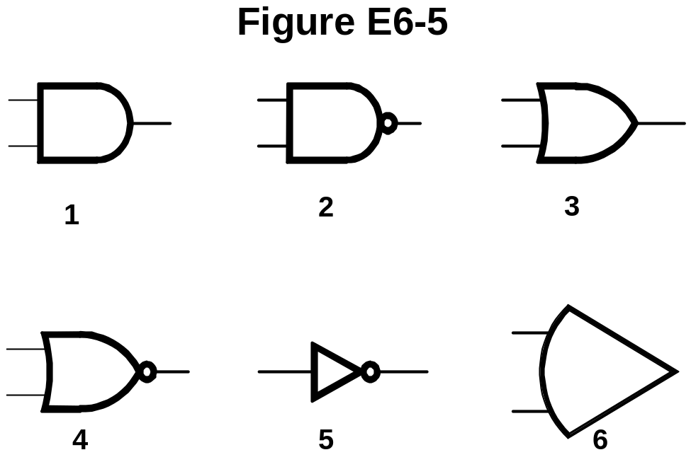
E6C07 In Figure E6-5, what is the schematic symbol for an AND gate?
1
2
3
4

Slide 20
E6C08 In Figure E6-5, what is the schematic symbol for a NAND gate?
1
2
3
4

Slide 21
E6C09 In Figure E6-5, what is the schematic symbol for an OR gate?
2
3
4
6

Slide 22
E6C10 In Figure E6-5, what is the schematic symbol for a NOR gate?
1
2
3
4

Slide 23
E6C11 In Figure E6-5, what is the schematic symbol for the NOT operation (inverter)?
2
4
5
6

Slide 24
E7A01 What is a bistable circuit?
An "AND" gate
An "OR" gate
A flip-flop
A clock

Slide 25
E7A02 How many output level changes are obtained for every two trigger pulses applied to the input of a "T" flip-flop circuit?
None
One
Two
Four

Slide 26
E7A03 Which of the following can divide the frequency of pulse train by 2?
An XOR gate
A flip-flop
An OR gate
A multiplexer

Slide 27
E7A04 How many flip-flops are required to divide a signal frequency by 4?
1
2
4
8

Slide 28
E7A05 Which of the following is a circuit that continuously alternates between two unstable states without an external clock?
Monostable multivibrator
J-K Flip-Flop
T Flip-Flop
Astable Multivibrator

Slide 29
E7A06 What is a characteristic of a monostable multivibrator?
It switches momentarily to the opposite binary state and then returns, after a set time, to its original state
It is a clock that produces a continuous square wave oscillating between 1 and 0
It stores one bit of data in either a 0 or 1 state
It maintains a constant output voltage, regardless of variations in the input voltage

Slide 30
E7A07 What logical operation does an AND gate perform?
It produces a logic "0" at its output only if all inputs are logic "1“
It produces a logic "1" at its output only if all inputs are logic "1“
It produces a logic "1" at its output if only one input is a logic "1“
It produces a logic "1" at its output if all inputs are logic "0"

Slide 31
E7A08 What logical operation does a NAND gate perform?
It produces a logic "0" at its output only when all inputs are logic "0“
It produces a logic "1" at its output only when all inputs are logic "1“
It produces a logic "0" at its output if some but not all of its inputs are logic "1“
It produces a logic "0" at its output only when all inputs are logic "1"

Slide 32
E7A09 What logical operation does an OR gate perform?
It produces a logic "1" at its output if any or all inputs are logic "1“
It produces a logic "0" at its output if all inputs are logic "1“
It only produces a logic "0" at its output when all inputs are logic "1“
It produces a logic "1" at its output if all inputs are logic "0"

Slide 33
E7A10 What logical operation does a NOR gate perform?
It produces a logic "0" at its output only if all inputs are logic "0“
It produces a logic "1" at its output only if all inputs are logic "1“
It produces a logic "0" at its output if any or all inputs are logic "1“
It produces a logic "1" at its output only when none of its inputs are logic "0"

Slide 34
E7A11 What is a truth table?
A table of logic symbols that indicate the high logic states of an op-amp
A diagram showing logic states when the digital device's output is true
A list of inputs and corresponding outputs for a digital device
A table of logic symbols that indicates the low logic states of an op-amp

Slide 35
E7A12 What is the name for logic which represents a logic "1" as a high voltage?
Reverse Logic
Assertive Logic
Negative logic
Positive Logic

Slide 36
E7A13 What is the name for logic which represents a logic "0" as a high voltage?
Reverse Logic
Assertive Logic
Negative logic
Positive Logic

Slide 37
E7F01 What is the purpose of a prescaler circuit?
It converts the output of a JK flip-flop to that of an RS flip-flop
It multiplies a higher frequency signal so a low-frequency counter can display the operating frequency
It prevents oscillation in a low-frequency counter circuit
It divides a higher frequency signal so a low-frequency counter can display the operating frequency

Slide 38
E7F02 Which of the following would be used to reduce a signal’s frequency by a factor of ten?
A preamp
A prescaler
A marker generator
A flip-flop

Slide 39
E7F03 What is the function of a decade counter digital IC?
It produces one output pulse for every ten input pulses
It decodes a decimal number for display on a seven-segment LED display
It produces ten output pulses for every input pulse
It adds two decimal numbers together

Slide 40
E7F04 What additional circuitry must be added to a 100-kHz crystal-controlled marker generator so as to provide markers at 50 and 25 kHz?
An emitter-follower
Two frequency multipliers
Two flip-flops
A voltage divider

Slide 41
E7F05 Which of the following circuits can be combined to produce a 100 kHz fundamental signal with harmonics at 100 kHz intervals?
A 10 MHz oscillator and a flip-flop
A 1 MHz oscillator and a decade counter
A 1 MHz oscillator and a flip-flop
A 100 kHz oscillator and a phase detector

Slide 42
E7F06 Which of these choices best describes a crystal marker generator?
A low-stability oscillator that sweeps through a band of frequencies
An oscillator often used in aircraft to determine the craft's location relative to the inner and outer markers at airports
A crystal-controlled oscillator with an output frequency and amplitude that can be varied over a wide range
A crystal-controlled oscillator that generates a series of reference signals at known frequency intervals

Slide 43
E7F07 Which type of circuit would be a good choice for generating a series of harmonically related receiver calibration signals?
A Wein-bridge oscillator followed by a class-A amplifier
A Foster-Seeley discriminator
A phase-shift oscillator
A crystal oscillator followed by a frequency divider

Slide 44
E7F08 What is one purpose of a marker generator?
To add audio markers to an oscilloscope
To provide a frequency reference for a phase locked loop
To provide a means of calibrating a receiver's frequency settings
To add time signals to a transmitted signal

Slide 45
E7F09 What determines the accuracy of a frequency counter?
The accuracy of the time base
The speed of the logic devices used
Accuracy of the AC input frequency to the power supply
Proper balancing of the mixer diodes

Slide 46
E7F10 How does a conventional frequency counter determine the frequency of a signal?
It counts the total number of pulses in a circuit
It monitors a WWV reference signal for comparison with the measured signal
It counts the number of input pulses occurring within a specific period of time
It converts the phase of the measured signal to a voltage which is proportional to the frequency

Slide 47
E7F11 What is the purpose of a frequency counter?
To provide a digital representation of the frequency of a signal
To generate a series of reference signals at known frequency intervals
To display all frequency components of a transmitted signal
To provide a signal source at a very accurate frequency

Slide 48
E7F12 What alternate method of determining frequency, other than by directly counting input pulses, is used by some frequency counters?
GPS averaging
Period measurement
Prescaling
D/A conversion

Slide 49
E7F13 What is an advantage of a period-measuring frequency counter over a direct-count type?
It can run on battery power for remote measurements
It does not require an expensive high-precision time base
It provides improved resolution of signals within a comparable time period
It can directly measure the modulation index of an FM transmitter

